Slide 1
Artificial Intelligence
CS-451
Instructor : Syed Musharaf Ali
ROOM G-104-DSE IIUI
Ph# 051-9019724 Ext-2724

Slide 2
Regression Analysis
Regression analysis is a form of predictive modelling technique which investigates the relationship between a dependent (target) and independent variable (s) (predictor).
Independent variables are inputs and dependent variables are output
This technique is used for forecasting, time series modelling and finding the cause effect relationship between the variables.
Examples: Oil price, temperature , Match outcome, Stock prices, Currency values prediction, etc
Notes:
Cognitve : process of knowing, learning

Slide 3
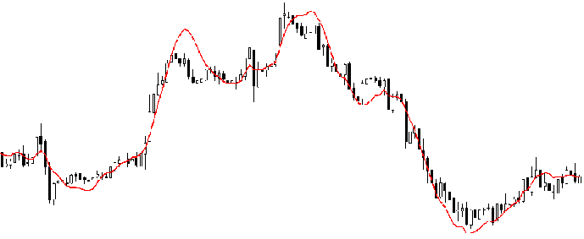
Regression Analysis
Regression analysis is an important tool for modelling and analysing data.
Here, we fit a curve / line to the data points, in such a manner that the differences between the distances of data points from the curve or line is minimized.
Notes:
Cognitve : process of knowing, learning

Slide 4
Why do we use Regression Analysis?
Regression analysis estimates the relationship between two or more variables.
Example:
If we want to estimate growth in sales of a company based on current economic conditions.
You have the recent company data which indicates that the growth in sales is around two and a half times the growth in the economy.
Using this insight, we can predict future sales of the company based on current & past information.
Notes:
Cognitve : process of knowing, learning

Slide 5
Benefits of using Regression Analysis?
There are multiple benefits of using regression analysis. They are as follows:
It indicates the significant relationships between dependent variable and independent variable.
It indicates the strength of impact of multiple independent variables on a dependent variable.
Regression analysis also allows us to compare the effects of variables measured on different scales
These benefits help market researchers / data analysts / data scientists to eliminate and evaluate the best set of variables to be used for building predictive models.
Notes:
Cognitve : process of knowing, learning

Slide 6
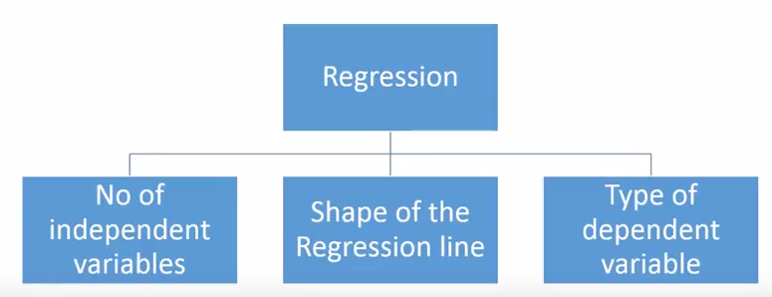
How many types of regression techniques do we have?
There are various kinds of regression techniques available to make predictions.
These techniques are mostly driven by three metrics (independent variables, dependent variables, and shape of regression line
Notes:
Cognitve : process of knowing, learning

Slide 7
1. Linear Regression
It is one of the most widely known modelling technique.
Linear regression is usually among the first few topics which people pick while learning predictive modelling.
In this technique, the dependent variable is continuous, independent variable(s) can be continuous or discrete, and nature of regression line is linear.
Linear Regression establishes a relationship between dependent variable (Y) and one or more independent variables (X) using a best fit straight line (also known as regression line).
Notes:
Cognitve : process of knowing, learning

Slide 8
1. Linear Regression
It is represented by an equation
Y=a + b*X + e
Similar to equation of line: y = mx+b
where a is intercept, b is slope of the line, X is input variable( independent variable) and e is error term.
This equation can be used to predict the value of target variable based on given predictor variable(s).
Notes:
Cognitve : process of knowing, learning

Slide 9
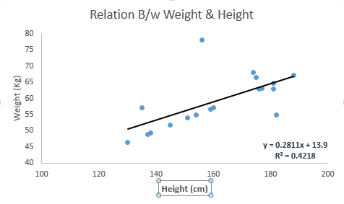
1. Linear Regression
Notes:
Cognitve : process of knowing, learning

Slide 10

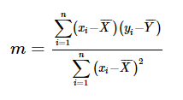

1. Linear Regression
How to obtain best fit line (Value of a and b)?
This task can be easily accomplished by Least Square Method.
It is the most common method used for fitting a regression line.
For data points
y=mx+b, where m and b can be calculated by
Notes:
Cognitve : process of knowing, learning

Slide 11
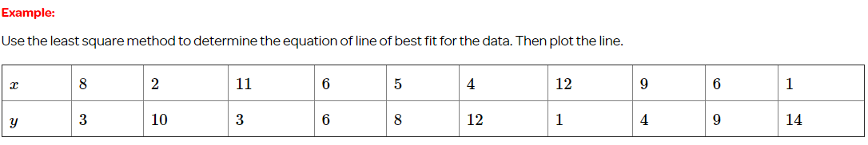
1. Linear Regression
How to obtain best fit line (Value of a and b)?
Notes:
Cognitve : process of knowing, learning

Slide 12
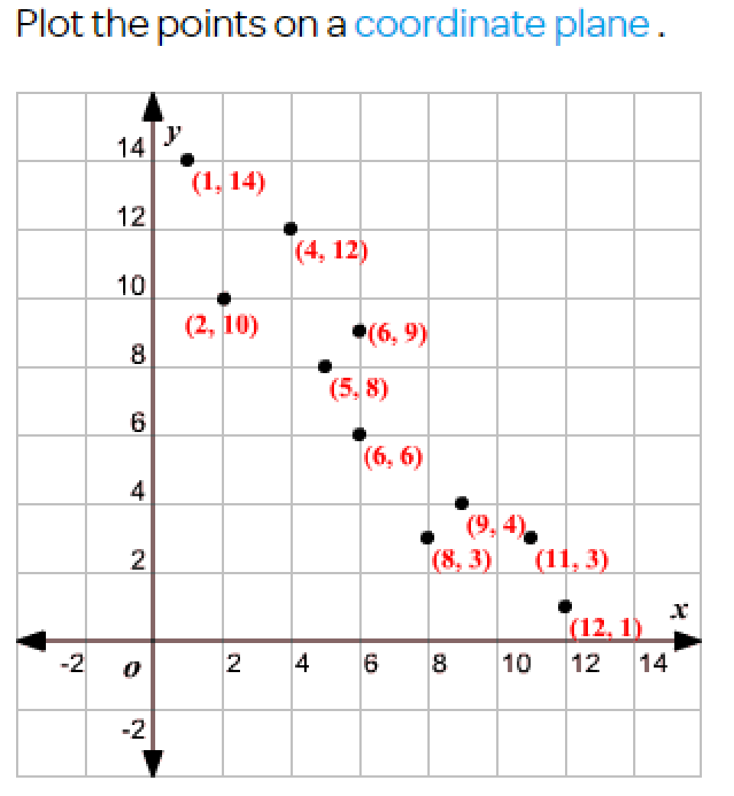
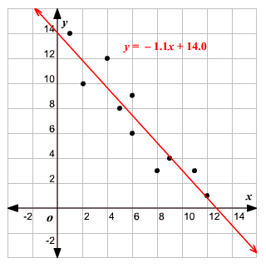
1. Linear Regression
How to obtain best fit line (Value of a and b)?
Notes:
Cognitve : process of knowing, learning

Slide 13
1. Linear Regression
Important points
There must be linear relationship between independent and dependent variables
Linear Regression is very sensitive to Outliers. It can terribly affect the regression line and eventually the forecasted values.
Notes:
Cognitve : process of knowing, learning

Slide 14
1. Linear Regression
Example: Find the final score of the team in the T20 match where scores of 15 overs are given
(5,25), (10, 80), (15, 120), (20, ?)
By equations we found that
m = 9.5
b = -20
Substitute values for m and b for the given X in equation
y = mx+b
Notes:
Cognitve : process of knowing, learning

Slide 15
1. Linear Regression
Example: Find the final score of the team in the T20 match where scores of 15 overs are given
(5,25), (10, 80), (15, 120), (20, ?)
By equations we found that
m = 9.5
b = -20
For
x = 5 , y = 27.5
x = 10, y = 75
x = 15, y = 122.5
x = 20, y = 170
Notes:
Cognitve : process of knowing, learning

Slide 16
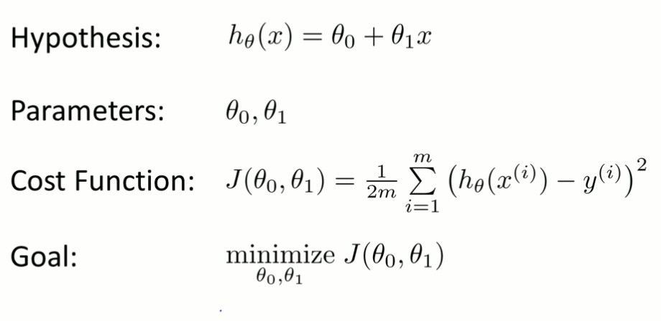
1. Linear Regression
Cost Function
It is a function that measures the performance of a Machine Learning model for given data. Cost Function quantifies the error between predicted values and expected values and presents it in the form of a single real number.
Notes:
Cognitve : process of knowing, learning

Slide 17
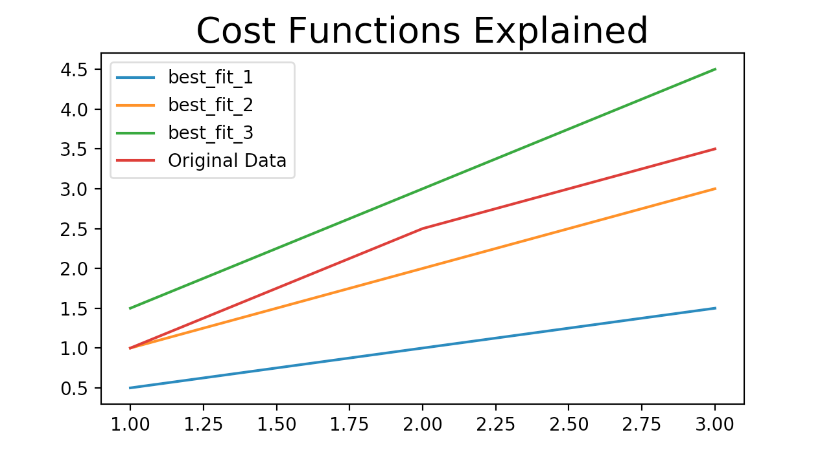
1. Linear Regression
Cost Function Example
https://medium.com/@lachlanmiller_52885/understanding-and-calculating-the-cost-function-for-linear-regression-39b8a3519fcb
Notes:
Cognitve : process of knowing, learning

Slide 18
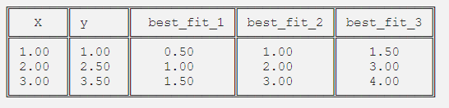
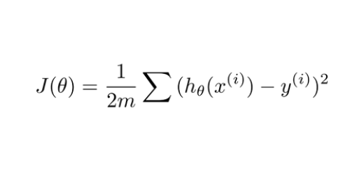
1. Linear Regression
Cost Function Example
Cost function values
best_fit_1: 1.083 best_fit_2: 0.083 best_fit_3: 0.25
Notes:
Cognitve : process of knowing, learning

Slide 19
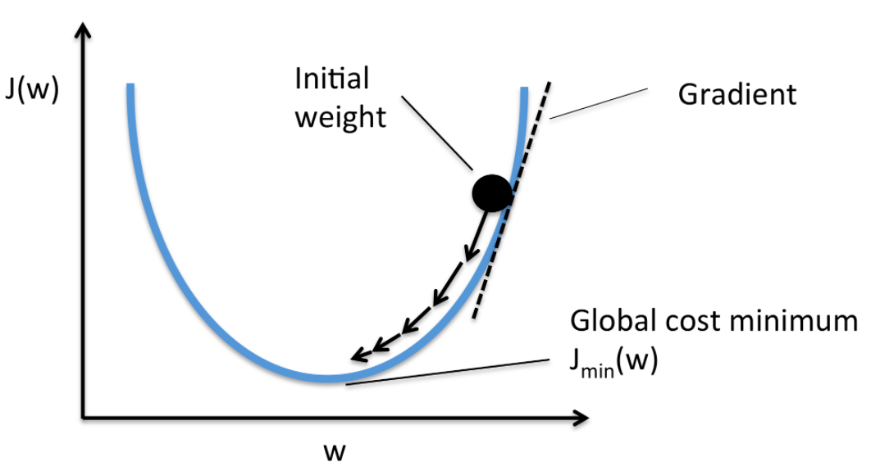
1. Linear Regression
Gradient Descent
Gradient descent is an optimization algorithm used to minimize some function by iteratively moving in the direction of steepest descent as defined by the negative of the gradient. In machine learning, gradient descent to update the parameters of our model.
Gradient descent for one parameter
Notes:
Cognitve : process of knowing, learning

Slide 20
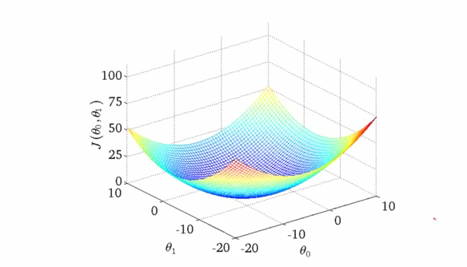
1. Linear Regression
Gradient Descent
Gradient descent for two parameter
Notes:
Cognitve : process of knowing, learning

Slide 21

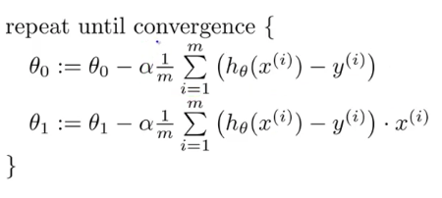
1. Linear Regression
Gradient Descent
Gradient descent is an optimization algorithm used to find the values of parameters (coefficients) of a function (f) that minimizes a cost function (cost).
Parameters update where α is learning rate
Notes:
Cognitve : process of knowing, learning

Slide 22
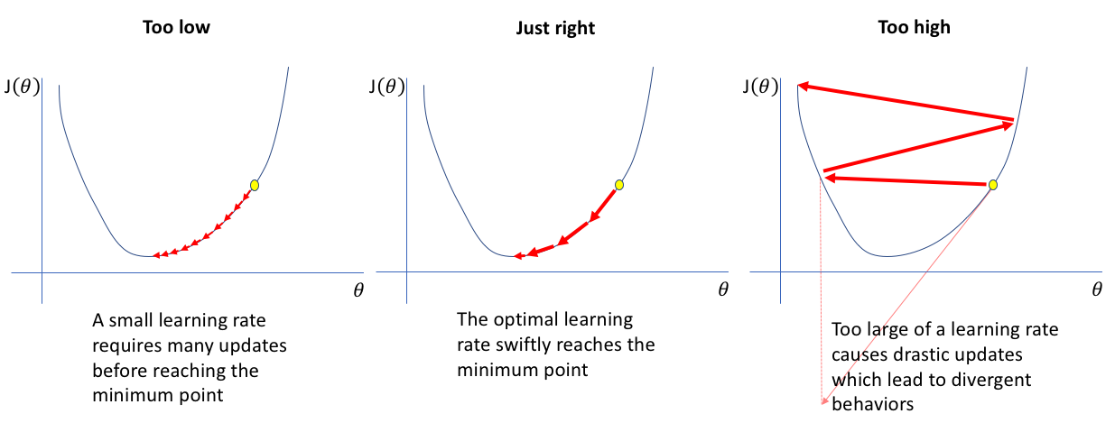
1. Linear Regression
Gradient Descent
Learning rate α update
Notes:
Cognitve : process of knowing, learning

Slide 23
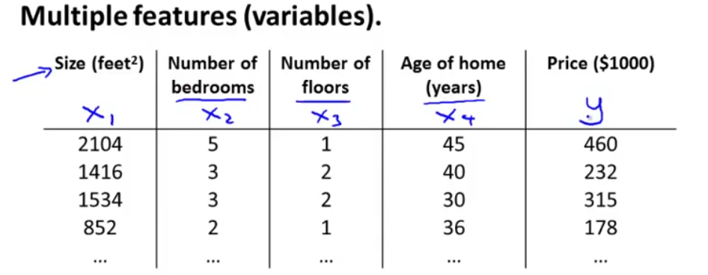
1. Multivariate Linear Regression
Linear regression with multiple features
Notes:
Cognitve : process of knowing, learning

Slide 24
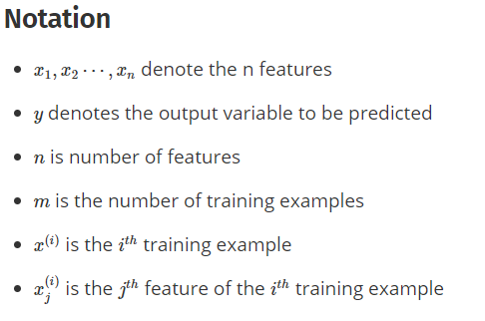
1. Multivariate Linear Regression
Linear regression with multiple features
Notes:
Cognitve : process of knowing, learning

Slide 25
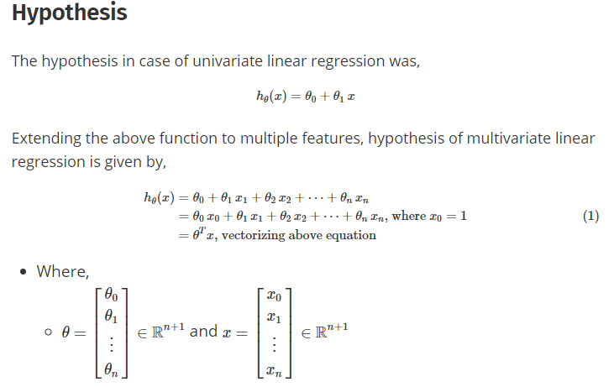
1. Multivariate Linear Regression
Linear regression with multiple features
Notes:
Cognitve : process of knowing, learning

Slide 26
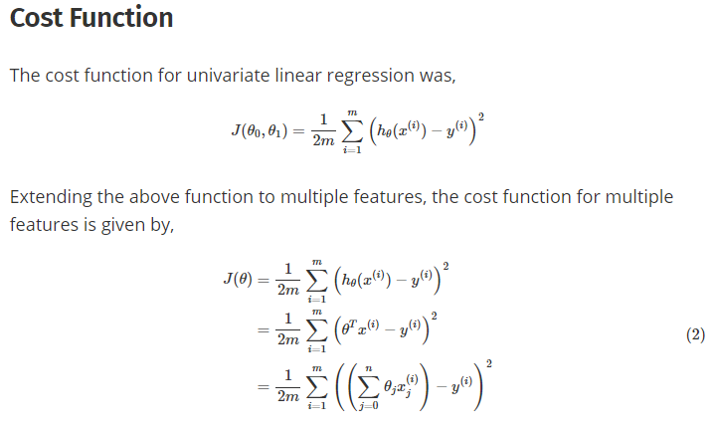
1. Multivariate Linear Regression
Linear regression with multiple features
Notes:
Cognitve : process of knowing, learning

Slide 27
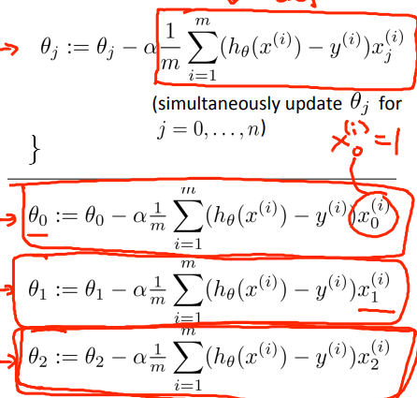
1. Multivariate Linear Regression
Linear regression with multiple features
Gradient Descent
Notes:
Cognitve : process of knowing, learning

Slide 28
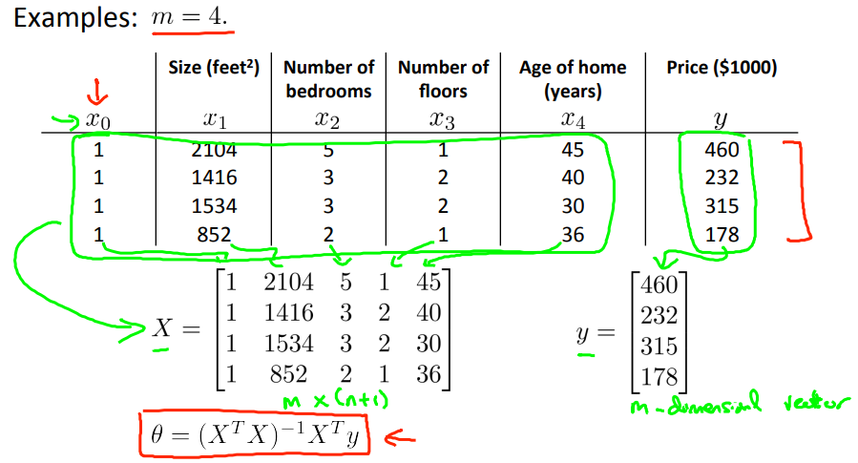
1. Multivariate Linear Regression
Linear regression with multiple features
Normal Equation: Method to solve parameters θ
Notes:
Cognitve : process of knowing, learning

Slide 29
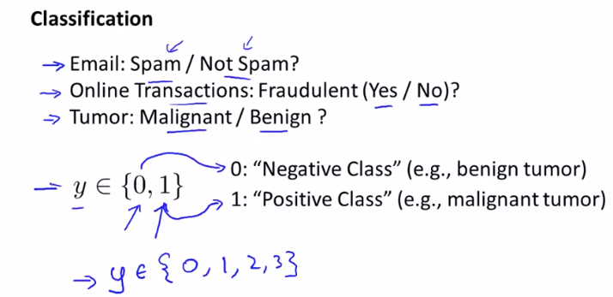
Notes:
Cognitve : process of knowing, learning

Slide 30
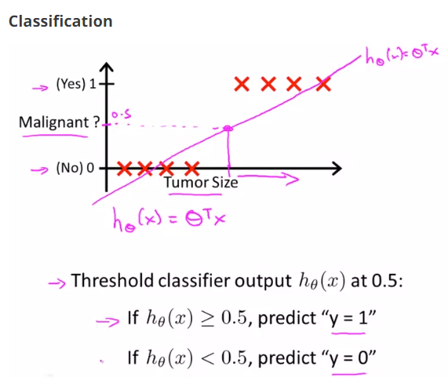
Notes:
Cognitve : process of knowing, learning

Slide 31
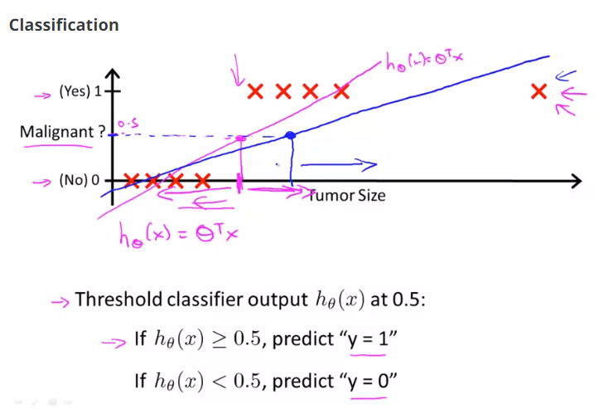
Notes:
Cognitve : process of knowing, learning

Slide 32
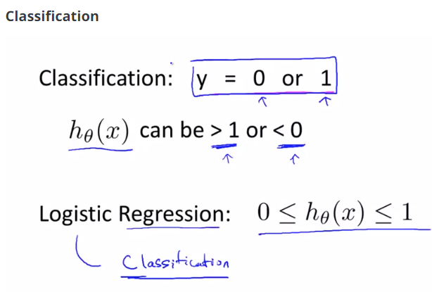
Notes:
Cognitve : process of knowing, learning

Slide 33
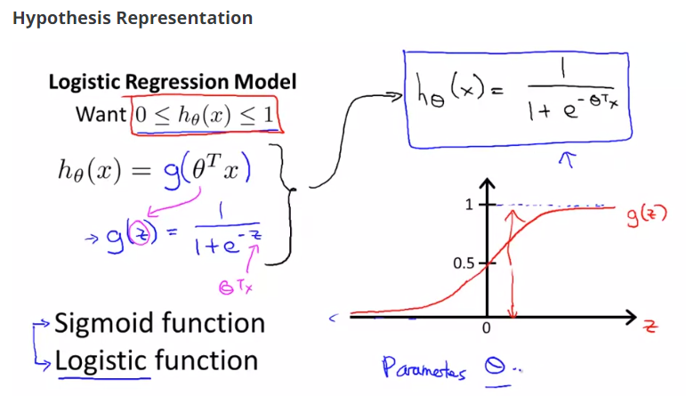
Notes:
Cognitve : process of knowing, learning

Slide 34
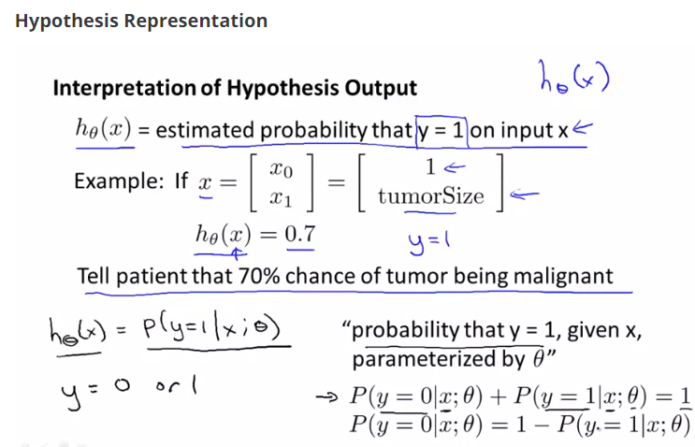
Notes:
Cognitve : process of knowing, learning

Slide 35
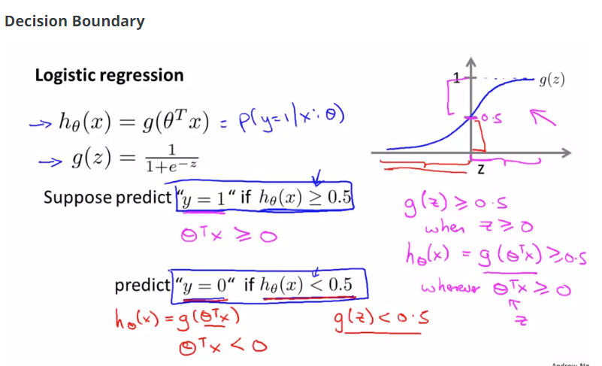
Notes:
Cognitve : process of knowing, learning

Slide 36
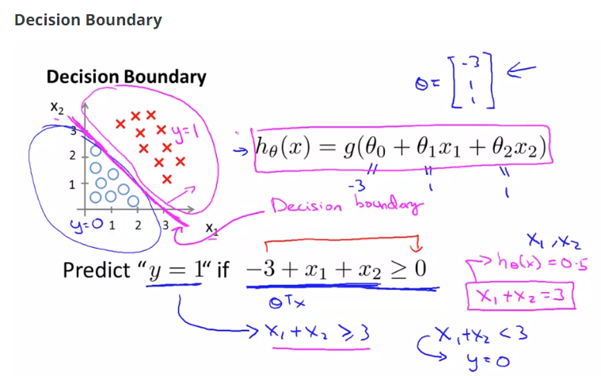
Notes:
Cognitve : process of knowing, learning

Slide 37
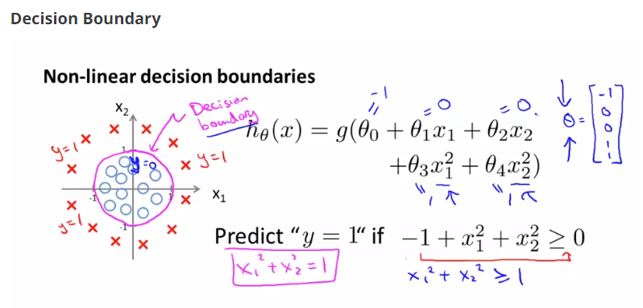
Notes:
Cognitve : process of knowing, learning

Slide 38
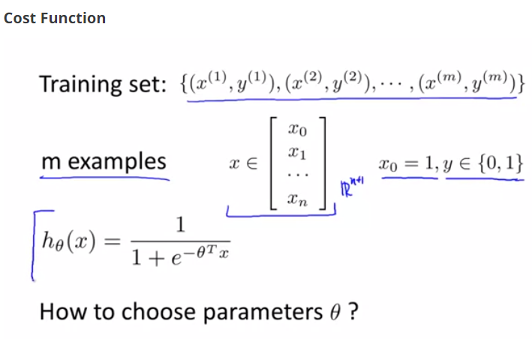
Notes:
Cognitve : process of knowing, learning

Slide 39
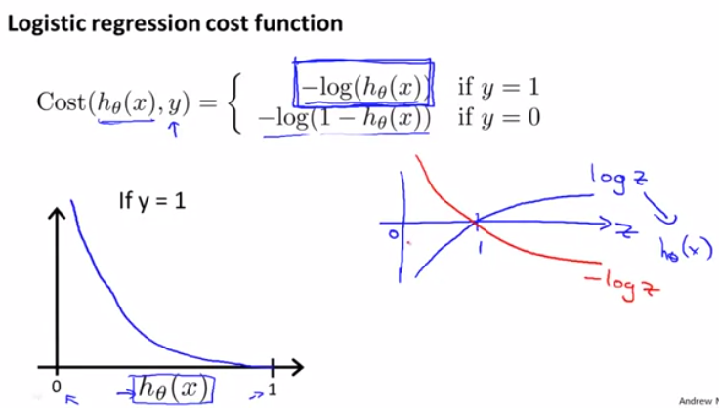
Notes:
Cognitve : process of knowing, learning

Slide 40
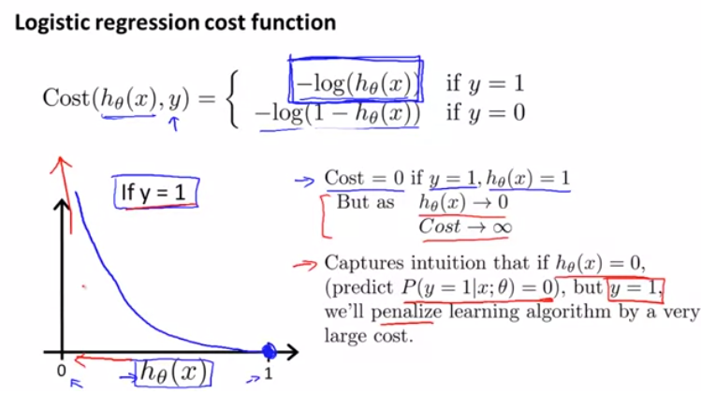
Notes:
Cognitve : process of knowing, learning

Slide 41
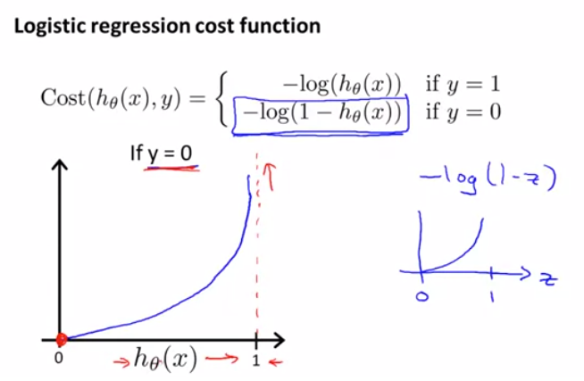
Notes:
Cognitve : process of knowing, learning

Slide 42
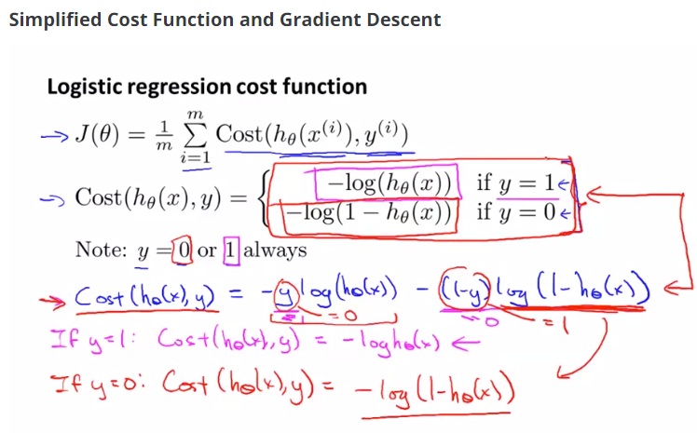
Notes:
Cognitve : process of knowing, learning

Slide 43
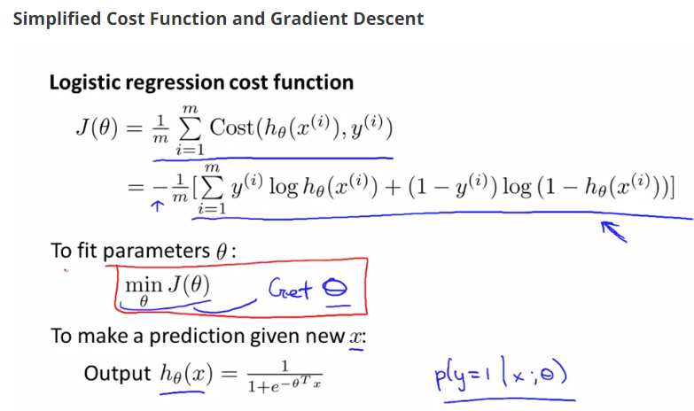
Notes:
Cognitve : process of knowing, learning

Slide 44
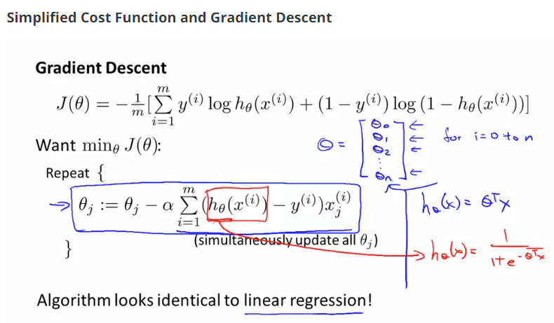
Notes:
Cognitve : process of knowing, learning

Slide 45
Notes:
Cognitve : process of knowing, learning

Slide 46
Notes:
Cognitve : process of knowing, learning

Slide 47
Notes:
Cognitve : process of knowing, learning

Slide 48
Notes:
Cognitve : process of knowing, learning

